Slide 1
NP-Completeness Dr. Tathagata Ray Assistant Professor, BITS Pilani, Hyderabad Campus rayt@hyderabad.bits-pilani.ac.in

Slide 2
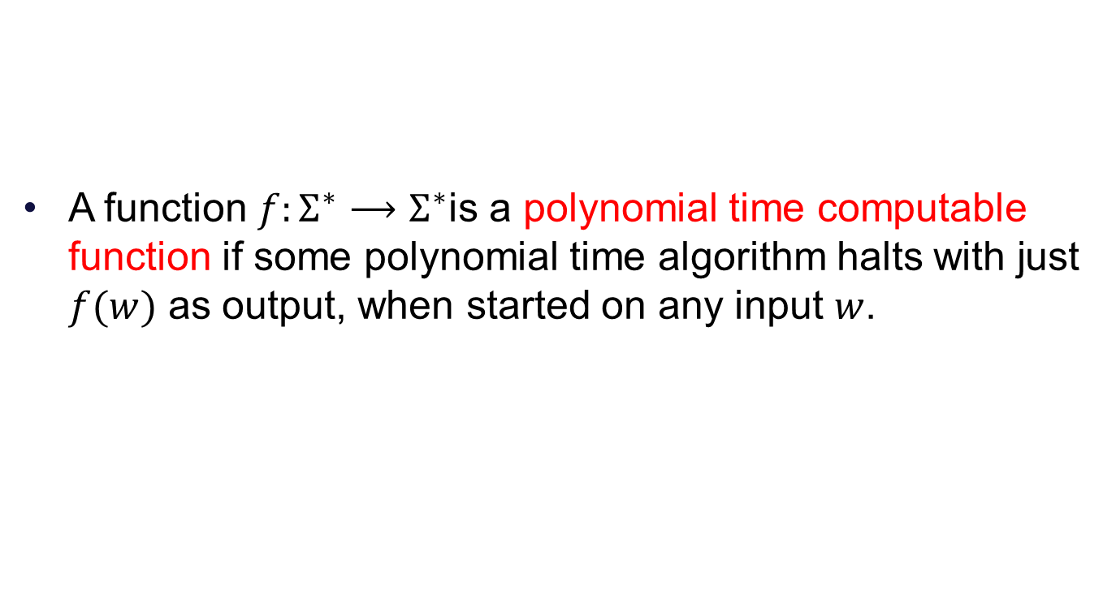
Polynomial time computability
A function $f:Σ^{∗}⟶Σ^{∗}$is a polynomial time computable function if some polynomial time algorithm halts with just $f(w)$ as output, when started on any input $w$.

Slide 3
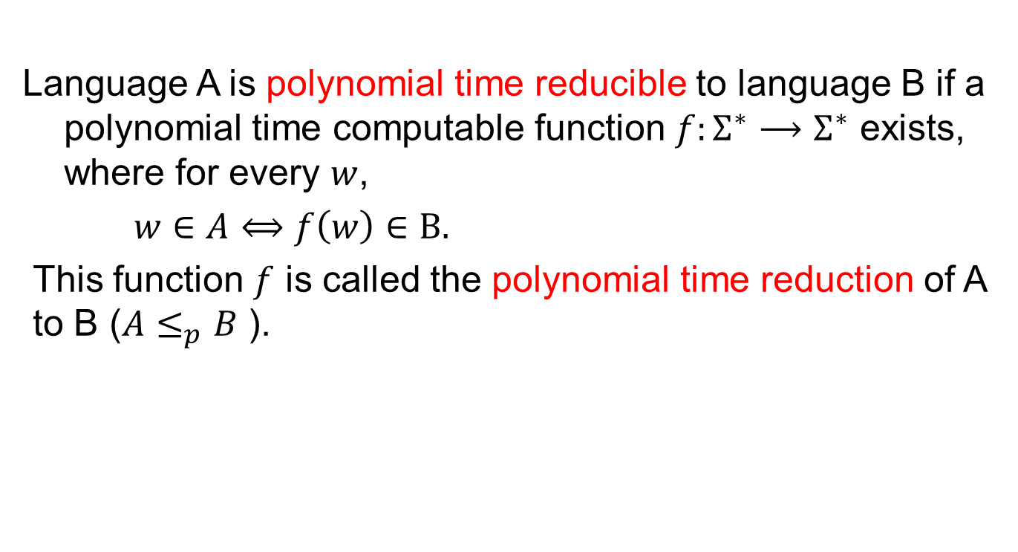
Polynomial time reducibility
Language A is polynomial time reducible to language B if a polynomial time computable function $f:Σ^{∗}⟶Σ^{∗}$ exists, where for every $w$,
$w∈A⟺f\left(w\right)∈B.$
This function $f$ is called the polynomial time reduction of A to B ($A≤_{p}B$ ).

Slide 4
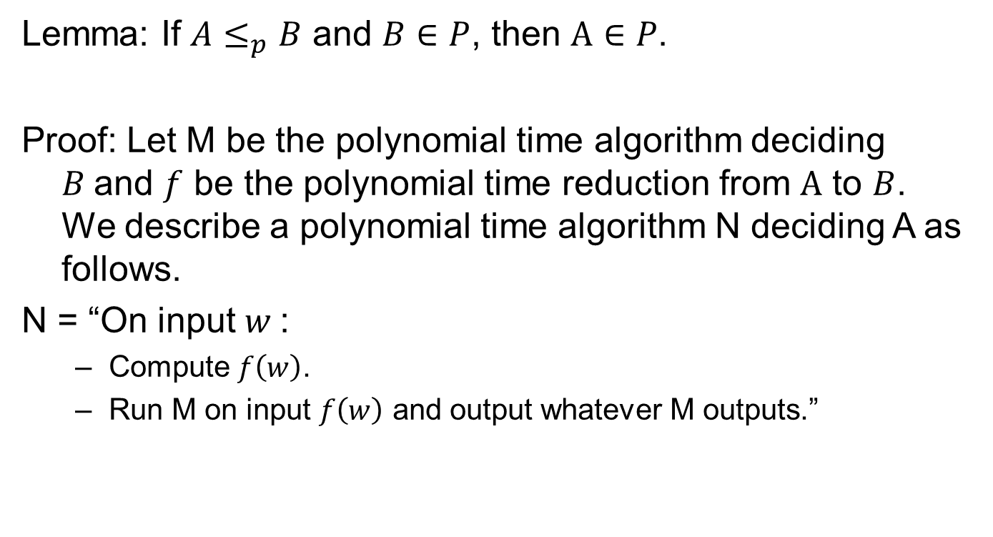
Lemma
Lemma: If $A≤_{p}B$ and $B∈P$, then $A∈P$.
Proof: Let M be the polynomial time algorithm deciding $B$and $f$ be the polynomial time reduction from $A$ to $B$. We describe a polynomial time algorithm N deciding A as follows.
N = “On input $w$:
Compute $f\left(w\right)$.
Run M on input $f\left(w\right)$ and output whatever M outputs.”

Slide 5




Graphically
N
Yes, $f(w)∈B$
Yes, $w∈A$
w
F
f(w)
M
No, $f(w)∉B$
No, $w∉A$

Slide 6
NP Completeness
A language B is NP-complete if it satisfies two conditions.
B is in NP.
Every A in NP is polynomial time reducible to B.

Slide 7
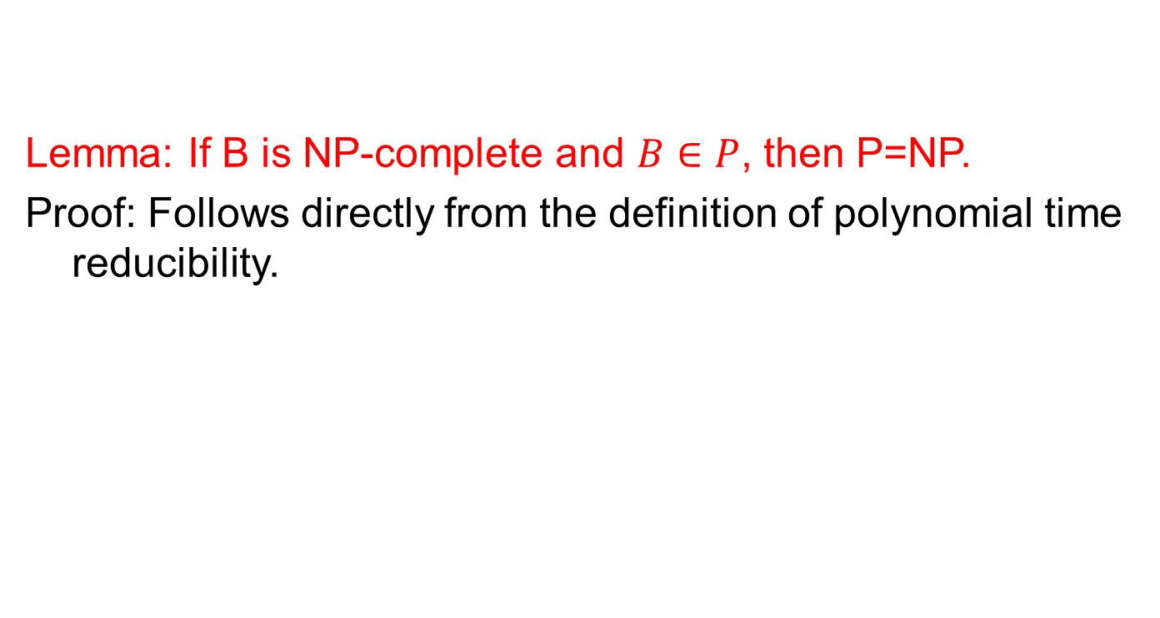
Lemma
Lemma: If B is NP-complete and $B∈P$, then P=NP.
Proof: Follows directly from the definition of polynomial time reducibility.

Slide 8
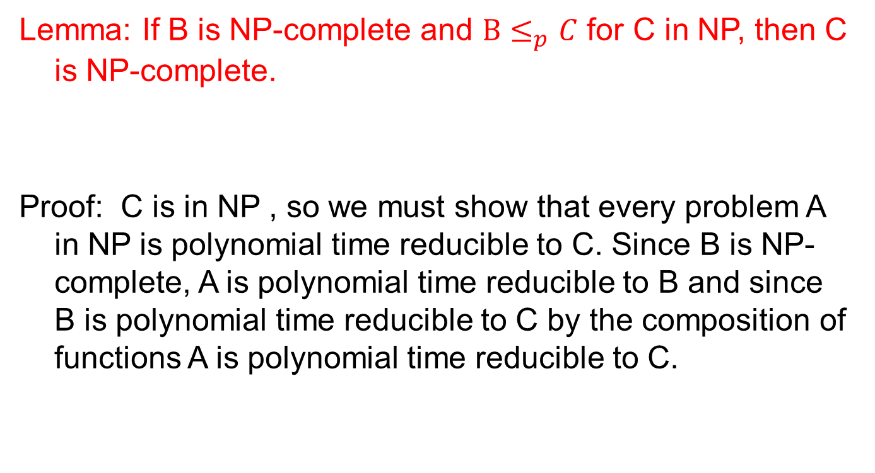
Lemma
Lemma: If B is NP-complete and $B≤_{p}C$ for C in NP, then C is NP-complete.
Proof: C is in NP , so we must show that every problem A in NP is polynomial time reducible to C. Since B is NP-complete, A is polynomial time reducible to B and since B is polynomial time reducible to C by the composition of functions A is polynomial time reducible to C.

Slide 9
Cook-Levin Theorem
We need to have one NP complete problem.
We may obtain other NP complete problems by polynomial time reduction from it.
Cook Levin Theorem: CIRCUIT-SAT is NP-complete.

